Slide 1

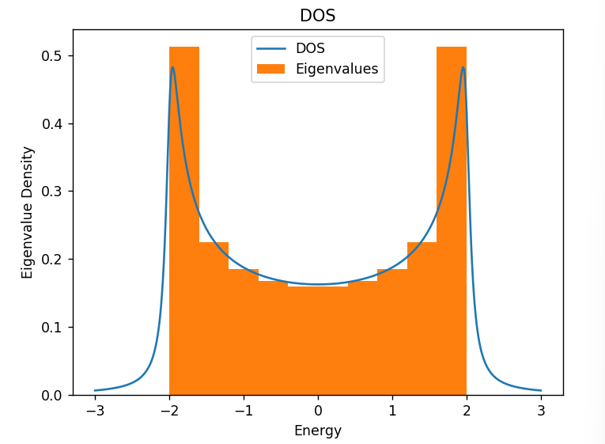
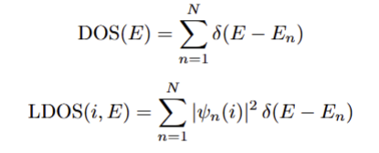

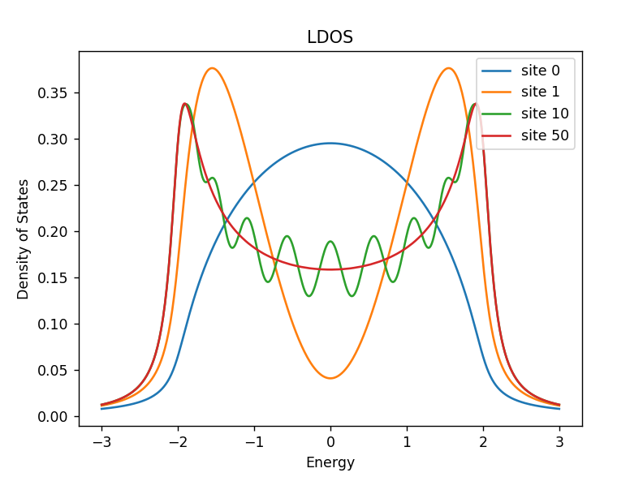
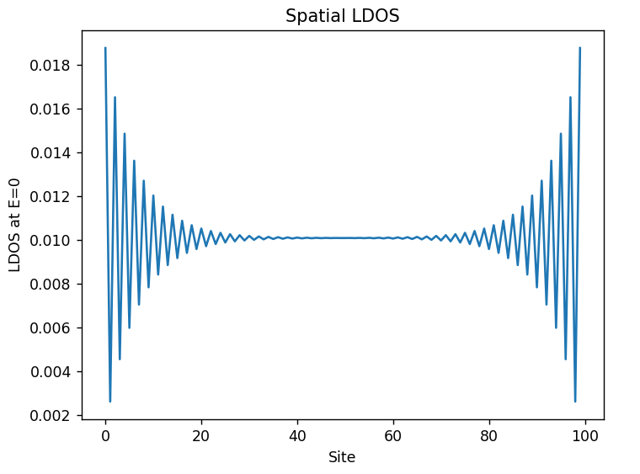
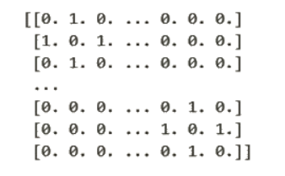
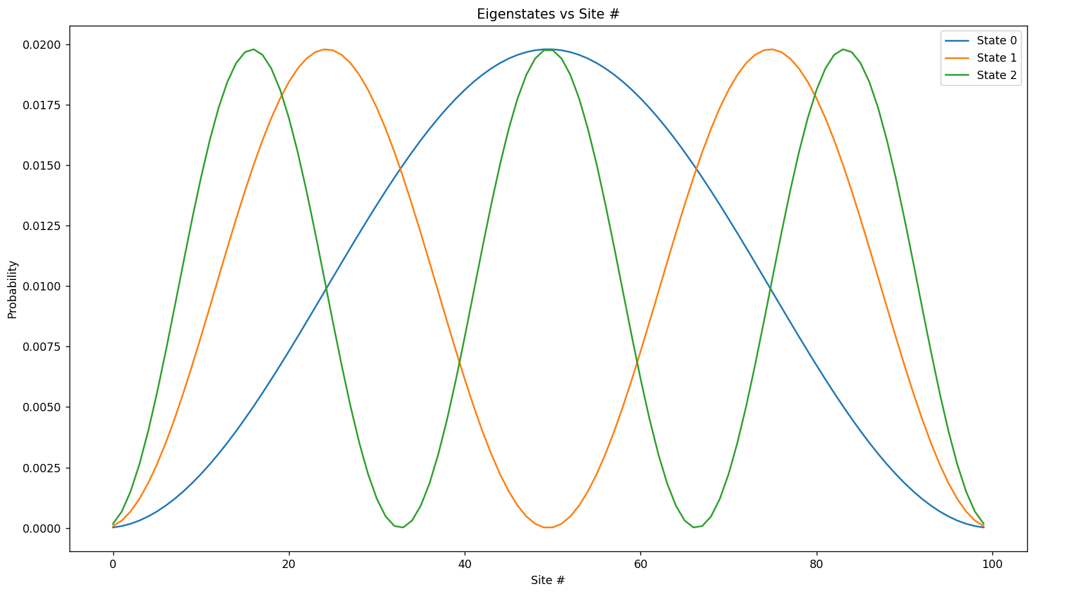



Analyzing Physical Phenomena Using a 1-D Tight-Binding Model
Alexander Tumanov, Nagananda Krishnamurthy
Abstract
Results
The tight-binding model is a quantum-mechanical framework for understanding the electronic structure of solids by treating electrons as primarily localized to atomic sites, with a small probability of hopping to neighboring atoms. In this project, a one-dimensional tight-binding chain is constructed and numerically solved to investigate how key quantities, such as the density of states (DOS) and local density of states (LDOS), emerge from the underlying band structure.
Following an approximation of the delta function-based definitions:
Background
The tight-binding chain used consisted of some N atoms arranged in a 1-D line. The boundaries of this chain behave as either an open or a periodic boundary condition (OBC and PBC) that correspond to a terminating N-atom chain and an infinite 1-D chain, respectively. The energy eigenvalues of the Hamiltonian are described by the following equation^{[1]}:
Where E_{o} is the on-site energy set to 0, while t and a are the hopping energy and lattice constant, respectively, set to t = 1 and a = 1 for this project. This can be visualized as a standing wave oscillating in the range of [E_{o} – 2t, E_{o} + 2t], being [-2, 2] in our case.
The DOS reveals how electronic states are distributed across energy, while the LDOS further resolves this picture spatially, showing how the availability of electronic states varies from site to site. These are characteristic distributions routinely studied in condensed matter physics and thus are the focus of this project.
The (OBC) band structure exhibits the characteristic van Hove singularities^{[2]} at the band edges, expected for a 1D system, and decays to zero beyond the energy range defined by the earlier eigenvalue equation ([-2, 2]). A spatially resolved LDOS revealing the transition from edge to bulk behavior is shown below.
Methods
This (OBC) Hamiltonian is then diagonalized using numpy.linalg.eigh()^{[3],} and the (squared) eigenstates are plotted:
Using the energy values of E_{o} = 0 and t = 1,
the following N x N Hamiltonian is constructed:
(Note that for a PBC Hamiltonian, the LDOS would instead be degenerate for all sites, as each site would be indistinguishable.)
Bibliography
[1]
D. Tong, Lectures on Applications of Quantum Mechanics, Chapter 2: Band Structure, University of Cambridge (2017). Available at: https://www.damtp.cam.ac.uk/user/tong/solidstate.html
L. Van Hove, "The Occurrence of Singularities in the Elastic Frequency Distribution of a Crystal," Phys. Rev. 89, 1189 (1953).
C. R. Harris et al., "Array programming with NumPy," Nature 585, 357–362 (2020).
[2]
These eigenstates and eigenvalues are then used to plot DOS and LDOS graphs to analyze our resulting band structure.
[3]
Notes:
Change:
Title
Add CEM/NSF logos
Authors
All Figures
Motivation
NZAFO Background
ODFMR background
Add Spinwave Instability Background
Fix Bibliography
Fix Acknowledgements
Fix Future Direction
Add Discussion

